Slide 1
Analog Communications
Signals and Communication Systems (24EC2105)

Slide 2
Single Tone Angle Modulation

Slide 3
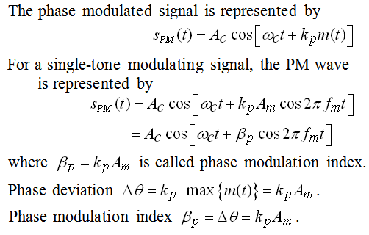
Single Tone Angle Modulation (PM)
Let a message signal

Slide 4
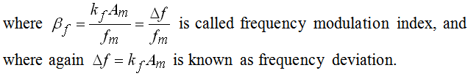
Single Tone Angle Modulation (FM)
For a single tone FM Modulation is given by

Slide 5
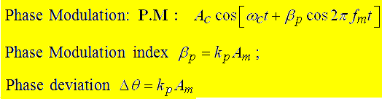
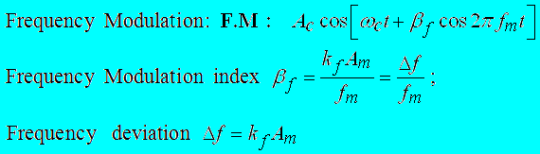
Brief Summary

Slide 6
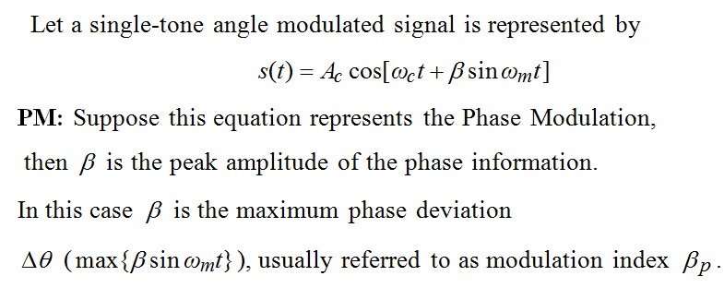

Phase and Frequency Deviations

Slide 7
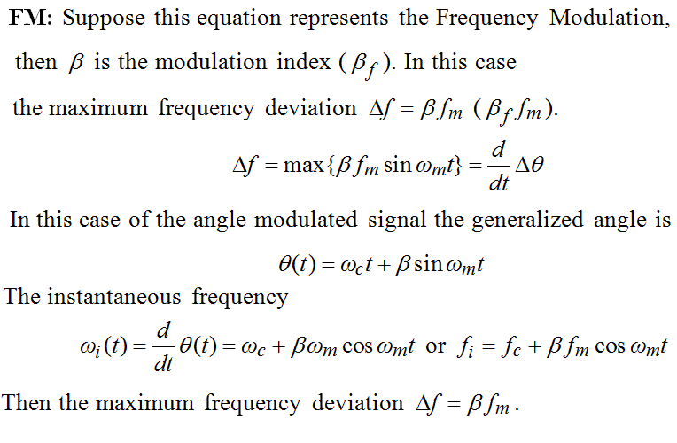
Phase and Frequency Deviation…

Slide 8
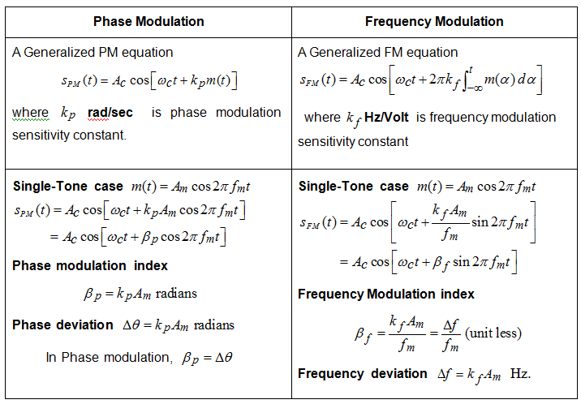

Slide 9
END

